Slide 1
REST API Security

Slide 2
Drivers
REST API becoming predominant in communication between client and server as well as in communication with external partners
OAuth2 / OpenID and JWT have become de facto standards for REST API authentication and authorisation
Change to stateless server application style
Web application architecture change from JSP/JSF to Single Page with REST API.
SRO currently does not have a common solution for REST API security. Different applications use different solutions.
Integration with myGov

Slide 3
Requirements
Support multiple authentication methods:
LDAP
Esys database
myGov
Use OpenID/OAuth2 standard
Allow for custom claims to be added to tokens
Sign tokens using asymmetric keys
Cater for logout

Slide 4
Options
Embedded library component with token generation and token store capability
External authorisation service that can be accessed by multiple applications at run time
Third party security provider product

Slide 5
Solution Outline
Short term create a Spring based OAuth2 security component with minimum custom code. Longer term evaluate and stand up a third party IAM product that satisfies SRO requirements.
Deploy this component as a separate service that will be remotely accessed from any Java application (client) that requires REST API security
Initially deploy this service on the existing WebSphere cluster, consider microservice architecture on Liberty or Tomcat and No-SQL database
Create token store on the existing Oracle database server using the schema from the Spring OAuth2 implementation
Cater for the following authentication methods:
LDAP
Custom (this covers esys, myGov and any combination of the above)
Custom authentication method to be configured as a REST endpoint on the Authentication server and implemented either within the client application or as a separate service
Allow for custom configuration for each client application, including authentication method, authentication server properties, token timeouts etc

Slide 6
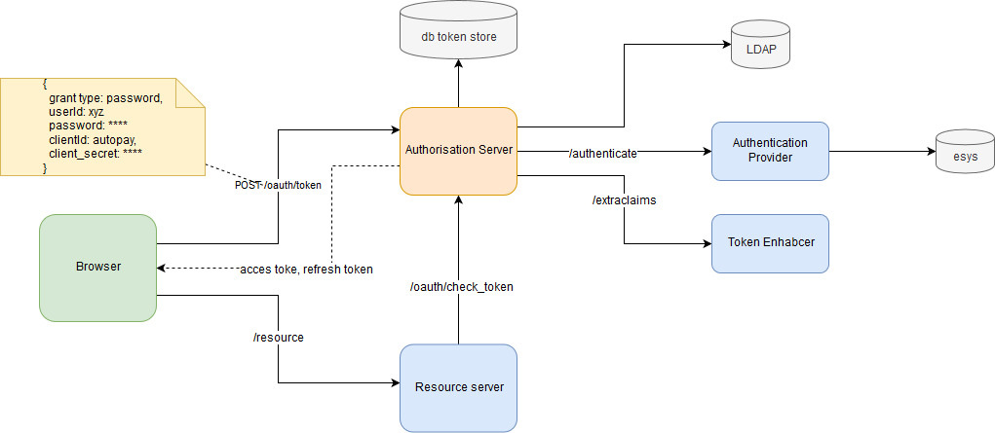
Solution Outline – Context

Slide 7
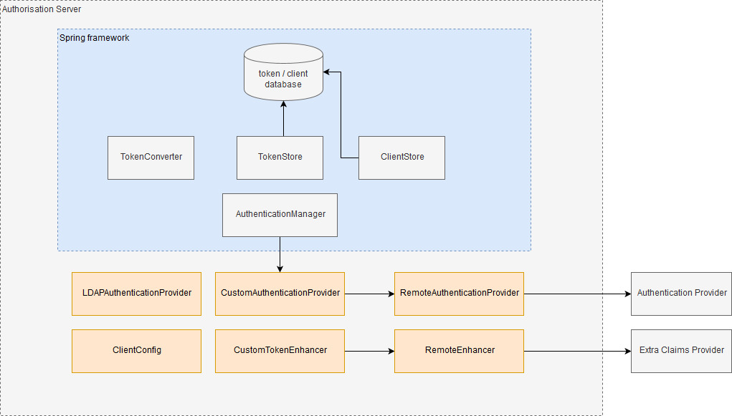
Authorisation Server Components

Slide 8
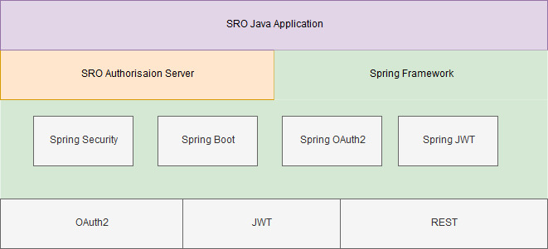
Solution Outline – Technology Stack

Slide 9
Solution Outline - API
Operation | API
Craete token | POST /oauth/token | grant_type=password
Verify token, get content | POST /oauth/check_token
Logout | POST /revoke/{tokenId} | Custom endpoint
Refresh token | POST /oauth/token | grant_type=refresh_token
Get encryption key | GET /oauth/token_key
Get access token | GET /oauth/token

Slide 10
Further consideration
Token style options
JWT
Binary
Liberty based OpenID provider
Current issues
JWT + JDBC troken store not provided out of the box in Spring
Basic Authentication enforced on Authorisation Server endpoints

